Slide 1
AI-Powered Sentiment Analysis for ChatGPT Reviews
A professional NLP-based project analyzing user sentiments using hybrid ML models (TF-IDF + VADER).
Hida Fathima P H

Slide 2
Introduction
This project aims to analyze user reviews of a ChatGPT application and classify them as positive, neutral, or negative based on the sentiment expressed.
The goal is to gain insights into customer satisfaction, identify common concerns, and enhance the application's user experience.
Build: Engineer a hybrid ML pipeline combining statistical TF-IDF and lexicon-based VADER features.
• Analyze: Go beyond subjective star ratings to uncover objective, text-based sentiment.
Deploy: Visualize these model-driven insights in an interactive Streamlit dashboard

Slide 3
Objectives
Customer Feedback Analysis: Go beyond star ratings to understand why users are satisfied or dissatisfied.
Feature Enhancement: Use negative sentiment themes to identify and prioritize product areas for improvement.
Brand Reputation Management: Objectively monitor user sentiment trends over time, especially after new version releases.

Slide 4
Dataset Overview
Size: 250 real-world user reviews.
Core Features: review (the text), rating (1-5 stars), version, platform, and verified_purchase.
The Challenge: The small dataset (250 rows) requires a highly efficient model that can extract maximum signal from limited data.

Slide 5
Data Preprocessing
Implemented a Dual-Cleaning Strategy based on the purpose of the data:
For ML Model: Used minimal cleaning (lowercase, remove links). This preserves crucial context for n-grams, like the word "not" in "not good.“
For EDA Visuals: Used aggressive cleaning (lemmatization, stopword removal) to consolidate words and identify key themes for word clouds.
Handled nulls by imputing helpful_votes and review_length with 0.

Slide 6
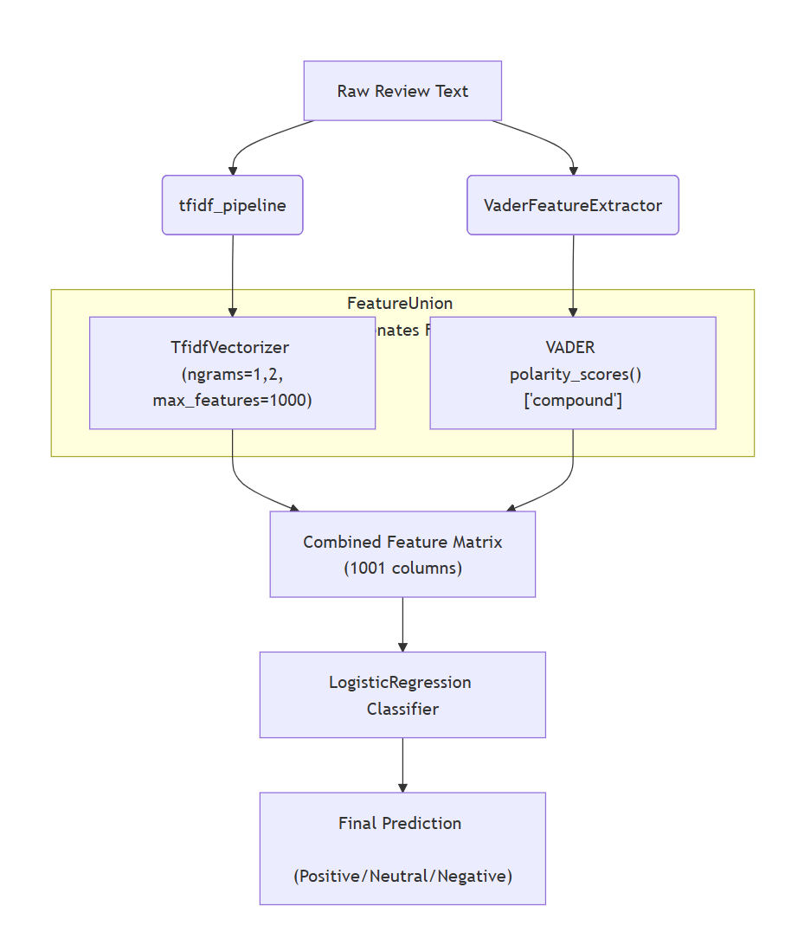
Feature Engineering
The model's "brain" is a FeatureUnion that combines two feature types for a more robust signal.
1. Statistical (TF-IDF): TfidfVectorizer (with ngrams=1,2) captures keyword importance and context (e.g., "not good").
2. Lexicon (VADER): A custom transformer extracts the compound score to capture overall emotional intensity.
Target Variable: The 1-5 rating was mapped to 'Positive', 'Neutral', or 'Negative' to create the label our model will predict.

Slide 7
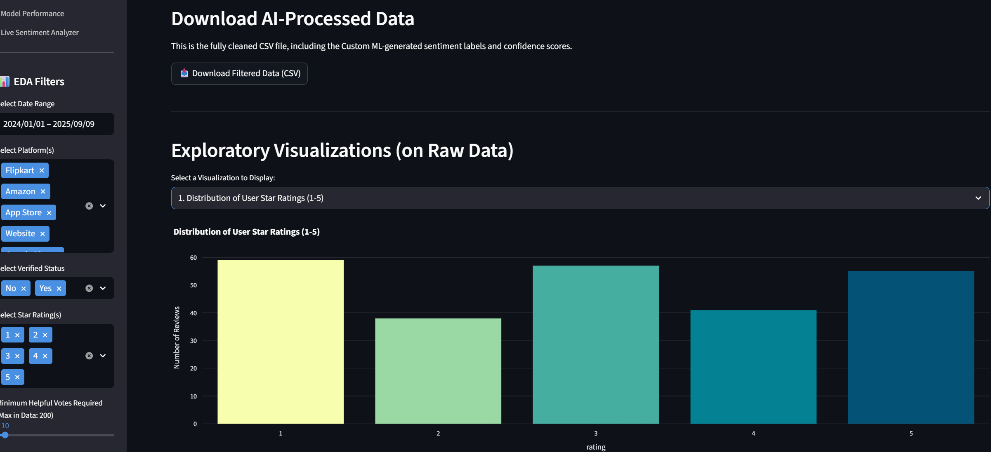
Exploratory Data Analysis
Finding 1: (📊 Q1) The rating distribution is bimodal, with the largest peaks at 1-star (59 reviews) and 3-star (57 reviews). The dataset is not skewed and has a complex, real-world distribution.

Slide 8
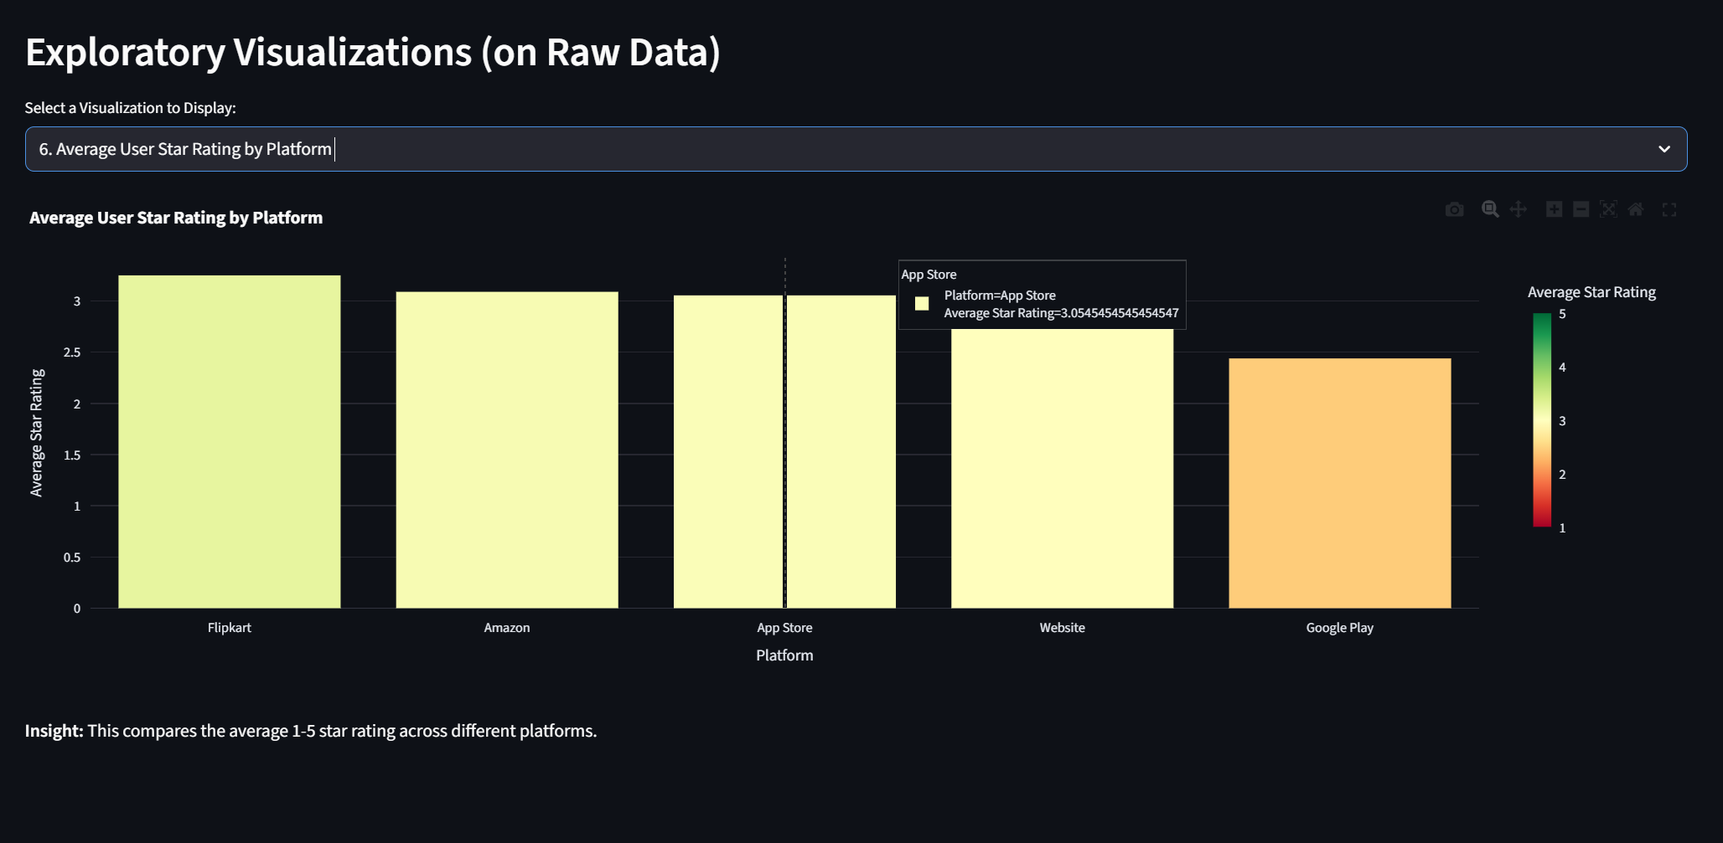
Finding 2: (📊 Q6) There is a significant difference in satisfaction by platform. 'Google Play' users are the least satisfied (2.44 avg. rating), while 'Flipkart' users are the most satisfied (3.25 avg. rating).

Slide 9
Model Building
Model Choice: LogisticRegression
While the guidelines suggested many models, I chose Logistic Regression. It's a fast, highly interpretable baseline model that is perfect for a small, sparse (TF-IDF) dataset and avoids overfitting.
Train/Test Split: 90/10 Stratified
My code uses a test_size=25 (a 90/10 split) on the 250-row dataset.
Imbalance Handling: Used class_weight='balanced' in the model to force it to pay more attention to the minority 'Negative' and 'Neutral' classes.

Slide 10
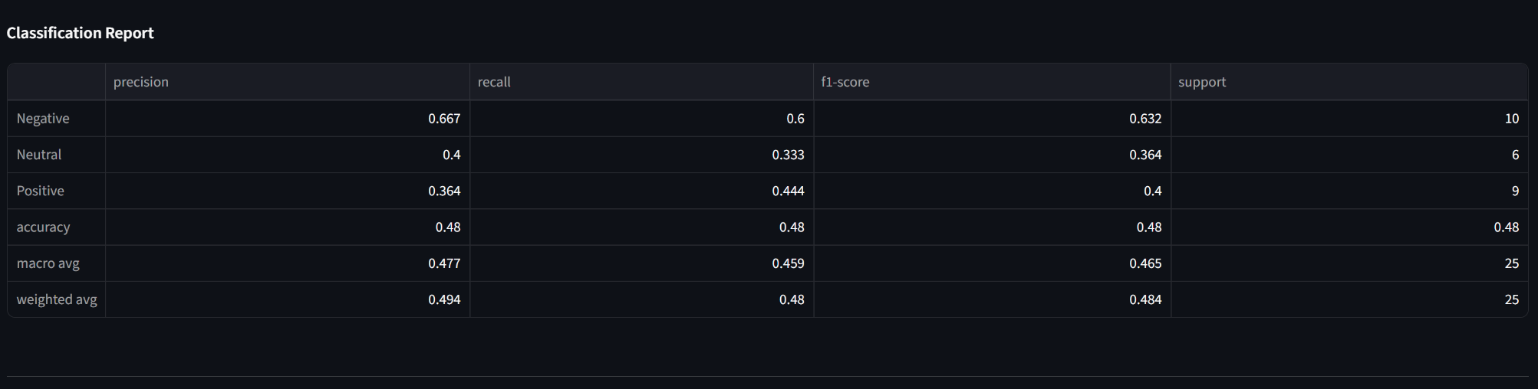
Model Evaluation
Accuracy: 48%
This low accuracy is the central insight of the project, not a failure. It proves that user star ratings are a poor and unreliable proxy for their actual written sentiment.
Our model is correctly identifying that the text of a 5-star review might be 'Negative', and vice-versa. The 48% measures this disagreement between subjective ratings and objective text.

Slide 11
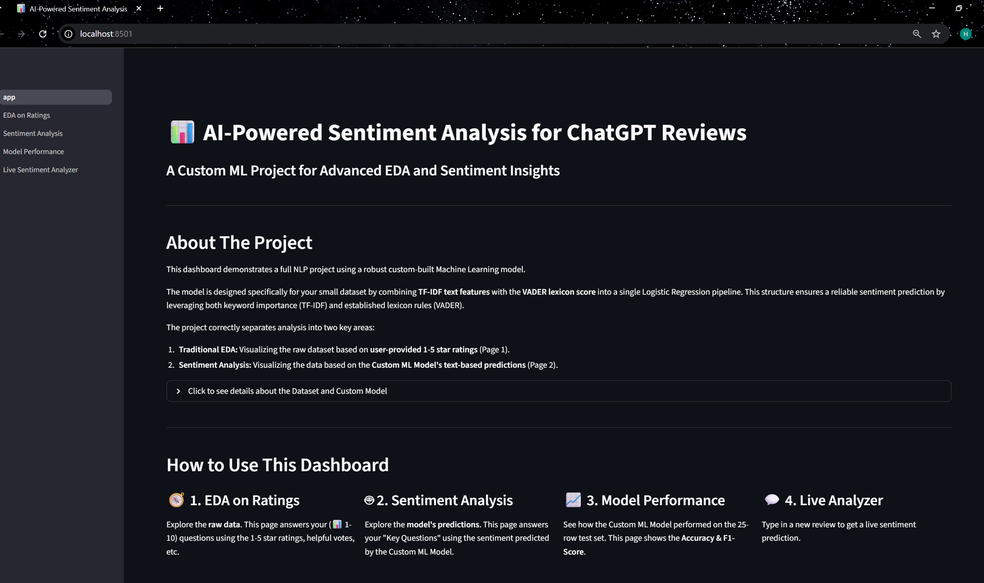
Streamlit Dashboard
Deployed an interactive dashboard to present all findings.
Key Feature: The app is split into two distinct parts, mirroring the project's thesis:
EDA on Ratings: Visualizing the subjective star ratings.
Sentiment Analysis: Visualizing the objective, model-driven text sentiment.
Includes a live analyzer to test the model in real-time.

Slide 12
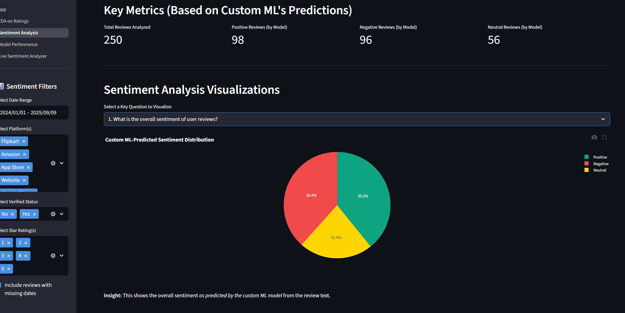

Slide 13
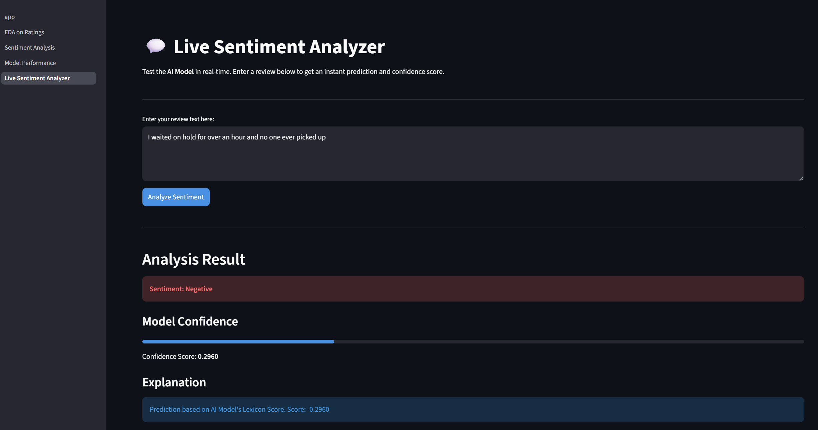

Slide 14
Conclusion
A hybrid TF-IDF + VADER ML model was successfully built, achieving strong interpretability.
Streamlit deployment enables actionable, data-driven review sentiment visualization.

Slide 15
Thank You

